Slide 1
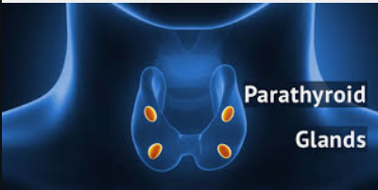
The Parathyroids, the Thyroid, and Ca²⁺ Regulation

Slide 2

Date: | Human Biology Year 12 ATAR
Do Now Do the past exam question provided about the thyroid. Lesson Agenda 1: Do Now 2: The Parathyroids Gland location and structure Hormone production and regulation Interaction with Thyroid to regulate Ca²⁺ Effects on target tissues 3: Do the review worksheet provided 4: Lesson summary and wind-up Suggested Study Read through today’s notes and textbook section. Finish and mark any questions you did not get to complete from the review worksheet. Practice drawing an annotated flow chart for Ca²⁺ regulation NEXT LESSON Formative Quiz on today’s work (not for marks) Growth Hormone; Adrenal Glands | Learning Aims Describe the structure and location of the parathyroid glands. Explain the effects parathyroid hormone (PTH) has on the body Discuss the effects thyrocalcitonin from the thyroid. Explain how the body maintains constant levels of calcium ion in the blood using thyrocalcitonin and PTH.
 | Key Vocabulary Negative feedback Homeostasis Set Point Regulation Target Tissues

Slide 3
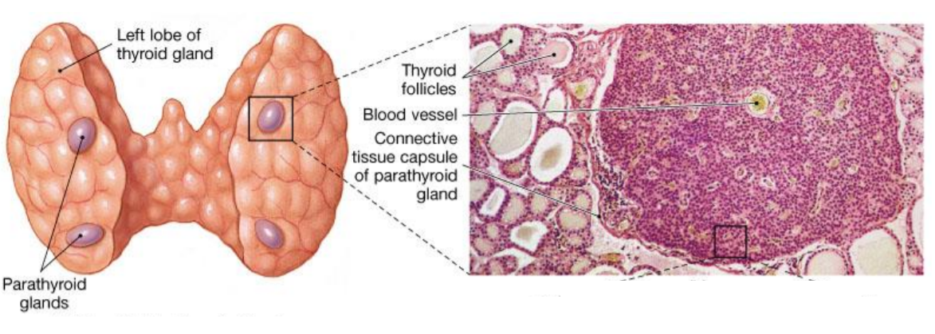
Parathyroid Location and Structure
The Parathyroids are separate endocrine glands embedded within the thyroid tissue.
Produce Parathyroid Hormone (PTH)
Learning Aim: Describe the structure and location of the parathyroid glands.

Slide 4
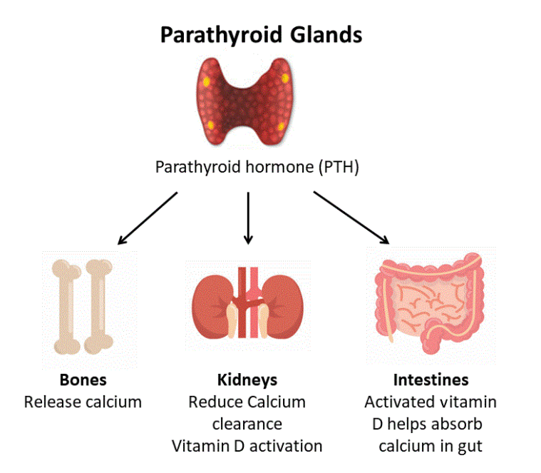
Parathyroid Hormone (PTH)
Produced when Ca²⁺ levels in the blood become too low.
Increases Ca²⁺ concentration in the blood by:
Increasing calcium reabsorbed into blood from renal tubules
Increases the amount of Ca²⁺ absorbed by the intestines from food
Triggers Ca²⁺ to be released from the bone matrix into the blood.
Works in balance with Thyrocalcitonin to maintain Calcium ion homeostasis
Also has a role in activating Vitamin D in the kidneys to increase Calcium absorption from food.
Learning Aim: Explain the effects parathyroid hormone (PTH) has on the body

Slide 5

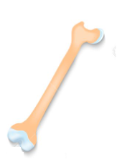
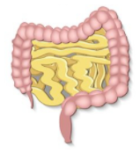
The Thyroid and Thyrocalcitonin
The thyroid gland also makes Thyrocalcitonin which is produced if Ca²⁺ levels in the blood are too high. *think back to Yr 11. Why would high blood Ca²⁺ be a problem?
Thyrocalcitonin reduces Ca²⁺ in the blood by:
Preventing Ca²⁺ from being reabsorbed by the kidney (so more is excreted in urine).
Promoting Ca²⁺ deposition in the bones (laying calcium down into the bone matrix).
Decreasing Ca²⁺ absorption by the intestines.
*note: Thyrocalcitonin works in balance with Parathyroid Hormone (PTH) produced by the Parathyroid.
Learning Aim: Explain the effects thyrocalcitonin has on the body

Slide 6
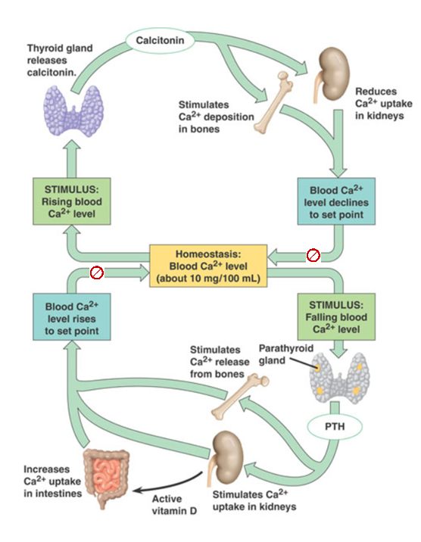
The Thyroid, the Parathyroids and Blood Ca²⁺ regulation
When blood calcium levels rise:
1: The thyroid gland releases thyrocalcitonin
2: Thyrocalcitonin:
Stimulates Ca²⁺ deposition in bones
Reduces Ca²⁺ uptake in kidneys
Inhibits Ca²⁺ absorption by intestines
3: When calcium levels stabilise to the set point, negative feedback prevents further release of thyrocalcitonin.
When blood calcium levels fall:
1: The parathyroid glands release PTH
2: PTH (Parathyroid hormone):
Stimulates Ca²⁺ release from bones
Increases Ca²⁺ uptake (resorption) in kidneys
Increases Ca²⁺ uptake by intestines.
3: When calcium levels stabilise to the set point, negative feedback prevents further release of PTH.
Learning Aim: Explain how the body maintains constant levels of calcium ion in the blood using thyrocalcitonin and PTH.

